Slide 1

AI in HealthcareMedical Imaging, Diagnostics & Personalized Medicine BY Group-4

Slide 2
CONTENTS
Introduction
Medical Imaging — What & Why
01
02
Diagnostics — Beyond Images
Personalized Medicine — Tailored Care
03
04
Benefits, Risks, and Good Practice
Why Deep Learning Fits Medical Imaging
05
06
Why Traditional Machine Learning Falls Short
Conclusion
07
08
References
09

Slide 3
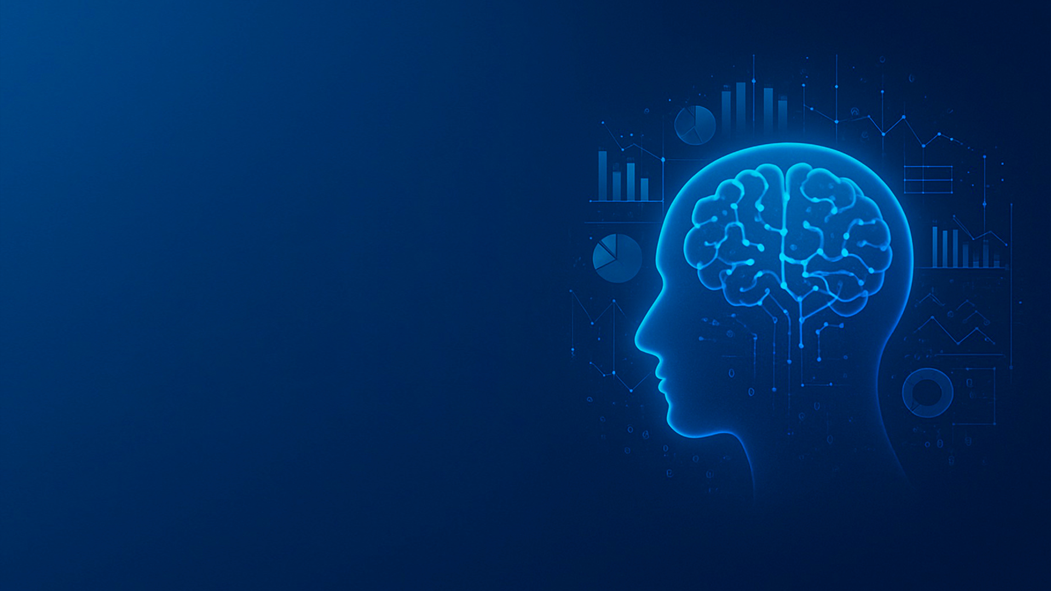
01
Introduction

Slide 4
Overview
Machine learning (ML) and deep learning (DL) are leading approaches in intelligent healthcare applications.
Focus on disease predictions, drug discovery, and medical image analysis.
Recent Advancements

Slide 5

Healthcare + AI: Quick Overview
Goals and Benefits
AI assists clinicians with data (images, lab results, EHR, genetics) for earlier detection, accurate diagnosis, and tailored treatments.
Key areasMedical Imaging, Diagnostics, and Personalized Medicine.
Benefitsspeed, consistency, and insights at scale across healthcare systems.
AI augments clinicians, improves quality and efficiency, and supports decision- making.

Slide 6
02
Medical Imaging — What & Why

Slide 7
Applications and Benefits
Computer Vision Applications
Applies computer vision to X- rays, CT, MRI, ultrasound, and pathology slides.
Detects patterns too subtle for the human eye; flags suspicious regions for review.
Helps with triage—highlighting urgent cases first to reduce time- to- treatment.
Supports screening programs (e.g., breast, lung) with consistent second reads.

Slide 8

Real-World Examples & Next Steps
Current Implementations
Next Steps
Imaging triage for stroke/bleeds; AI assist for mammography and lung nodule follow- up. Behold.aiUses AI to help radiologists diagnose disease with radiology scans. Prediction of Alzheimer’s disease: RSNA suggests AI can predict Alzheimer’s years earlier by identifying metabolic brain changes. EHR- based early- warning scores for sepsis and heart failure decompensation. Tumor profiling to select targeted therapies; pharmacogenomic dosing recommendations.
Start small (pilot), measure outcomes, train staff, expand responsibly.

Slide 9
Medical Imaging — How It Helps
Counts nodules, tracks change over time for objective follow- up.
Flags poor image quality or missing views before the patient leaves.
Quantification
Quality Control
Lesion Detection & Segmentation
Workflow Improvements
Outlines tumors, measures size and growth.
Pre- sorts studies, auto- fills measurements, and reduces repetitive tasks.

Slide 10
03
Diagnostics — Beyond Images

Slide 11


NLP for Clinical Notes
Summarization and Safety
Summarizes histories, pulls problems/meds/allergies into a clean view.
Detects potential adverse interactions or dosing errors.

Slide 12
04
Personalized Medicine — Tailored Care

Slide 13

Genomics and Clinical Data
Predictive Analysis
01.
Uses genomics + clinical data to predict disease risk and therapy response.

Slide 14
Oncology and Pharmacogenomics
Targeted Treatments
Matches tumor mutations to targeted drugs or immunotherapies.
Suggests drug/dose choices based on a person’s metabolism.

Slide 15
05
Benefits, Risks, and Good Practice

Slide 16
Benefits
Efficiency and Quality
Faster reads, fewer missed findings, consistent quality, and more time with patients.

Slide 17

Risks
Potential Issues
Bias, over- reliance, privacy and security concerns, and lack of explainability.

Slide 18
Good Practice
Implementation Guidelines
Human- in- the- loop, diverse training data, and clear audit trails.
Complianceprotect PHI, validate models clinically, and monitor performance over time.

Slide 19
06
Why Deep Learning Fits Medical Imaging

Slide 20

Advantages of Deep Learning
Handling Image Data
Handles large, unstructured image data and learns features automatically.
CNNs capture fine details—shapes, textures, edges—boosting detection and diagnostic accuracy.
Performance improves as more labeled data arrives, increasing prediction accuracy.

Slide 21
07
Why Traditional Machine Learning Falls Short

Slide 22


Limitations of Traditional ML
Feature Engineering
Relies on hand- crafted features and domain expertise, which may miss complex image patterns.
Struggles with high- dimensional parameters and spatial hierarchies common in medical images.
Typically delivers lower diagnostic accuracy compared to modern deep learning approaches.

Slide 23
08
Conclusion

Slide 24
Summary
Deep Learning Superiority
01
02
03
Deep learning—especially CNNs—best fits medical imaging because it learns rich, subtle image features automatically and scales its accuracy with more data.
Traditional ML struggles with complexity and spatial hierarchies, leading to lower diagnostic performance.
A human- in- the- loop deep learning workflow with strong data governance provides the most accurate, consistent, and clinically useful outcomes.

Slide 25
09
References

Slide 26
Sources
Reference List
01
Hippocratic AI. Home - Hippocratic AI. https://www.hippocraticai.com/
05
AIMultiple. Top 7 Technologies that Improve Insurance Underwriting. https://research.aimultiple.com/insurance- underwriting/
02
Nature. From social media to conference social. https://www.nature.com/articles/d41586- 019- 03853- 1
06
23andMe. DNA Genetic Testing For Health, Ancestry And More. https://www.23andme.com/
03
Stanford Medicine. WoebotAI- Powered Mental Health Support. https://med.stanford.edu/news/all- news/2021/06/ai- chatbot- mental- health.html
07
MIT Technology Review. Hundreds of AI tools have been built to catch covid. None of them helped. https://www.technologyreview.com/2021/07/30/1030329/machine- learning- ai- failed- covid- hospital- diagnosis- pandemic/
04
AIMultiple. Top 5 IBM Watson Competitors. https://research.aimultiple.com/ibm- watson- competitors/

Slide 27
Thanks

